Slide 1
Williams Homeless Outreach
Info. Meeting 9/23/13
5pm, Griffin 4

Slide 2
There is not one single cause that leads to homelessness
Low paying job/ loss of job
Lack of Affordable Housing
Lack of Affordable Health Care
Natural Disaster (Hurricane Irene, 2011)
Domestic Violence
Substance Abuse
Family Instability/Crisis
Physical/Mental Disability
Catastrophic Illness

Slide 3
National Demographics
In 2009, family homelessness accounted for 41% of the nation’s homeless population, and was the fastest growing sub-population of homelessness. (Source: National Coalition for the Homelessness)
Veterans are at the greatest risk for homelessness, with a 1 in 10 chance of experiencing it over the course of the year. (Source: 2009 Annual Homeless Assessment Report)
(Source: U.S. Conference of Mayors, 2006)

Slide 4
Local Demographics
Massachusetts Definition “an individual who both lacks a fixed, regular and adequate nighttime residence and who resides in emergency or transitional shelter programs, or who lives in places not designed for human habitation such as cars, abandoned buildings, the woods or the street. ”
The average age of a person experiencing homelessness in MA is 8 years old.

Slide 5
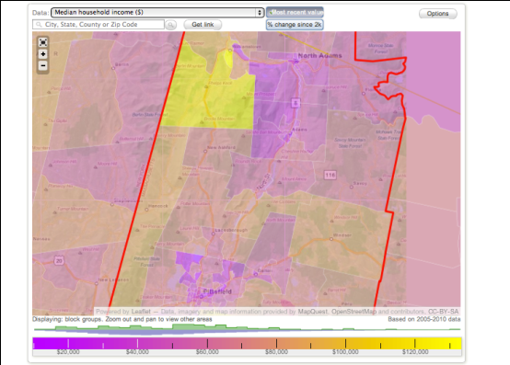
Berkshire County
Williamstown
North Adams
Pittsfield
Stats on homelessness in Berkshire County (BC) unavailable, but proportion of BC below the poverty line in the Adams/North Adams area, 5 miles East of Williamstown , ranges from 22% to 40%.
Source: http://www.city-data.com/county/Berkshire_County-MA.html

Slide 6

Volunteering:
http://www.youtube.com/watch?v=8FCJKZv__zY
1 in 45 U.S. Children=homeless each year (Source: America’s Youngest Outcasts: State Report Card on Child Homelessness, National Center on Family Homelessness)
Impact of Homelessness on Children
PAL= Playspace Activity Leader
Playspaces have books, art supplies, and developmental toys.

Slide 7

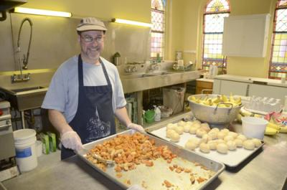
Volunteering:
Founded in 1986 by Williams College students.
Serves free, nutritionally balanced, expertly prepared lunch Noon-1pm Mon.-Fri. At the First Congregational Church in North Adams.
Volunteers needed for 12-1:30 cleanup shift (lunch included). Transportation free via BRTA bus.
http://www.youtube.com/watch?feature=player_embedded&v=PJ46_hm8xk8

Slide 8
Possible Future Projects
Benefit Concert for V-Day, with proceeds going towards Elizabeth Freeman Domestic Violence Center
Great Day of Service
Campus Forum/Speaker Bureau
National Advocacy
Holiday Food/Toy Drives
!?!?!?!?!?!YOUR IDEAS!?!?!?!?!?!

Slide 9
WHO Mission Statement
WHO is dedicated to raising campus awareness and enacting systemic change on the issue of homelessness, and factors contributing to homelessness, especially as they pertain to the local families of rural Massachusetts.
Co-chairs: Nitza Solis (nms1) and Jingyi Liu (jl8)

Slide 10
Sources
http://www.horizonsforhomelesschildren.org
http://www.mahomeless.org
http://www.nationalhomeless.org
http://www.pbs.org/now/shows/526/homeless-facts.html
http://www.homelessofhc.org/
http://www.berkshirefoodproject.org/
http://msnbcmedia.msn.com/i/MSNBC/Sections/NEWS/z-pdf-archive/homeless.pdf

